Slide 1

CSE430:Digital Signal Processing
DISCRETE-TIME SIGNALS AND SYSTEMS
Acknowledgement for lecture slides – Dr. Mohammad Zavid Parvez

Slide 2
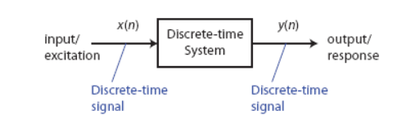
Terminology: Input-Output Description

Slide 3
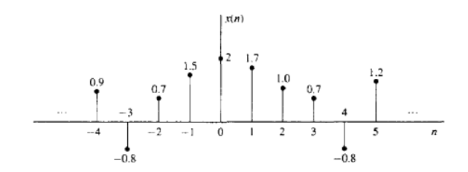
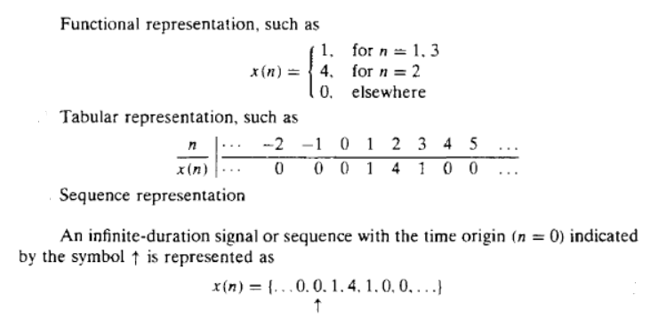
DISCRETE-TIME SIGNALS

Slide 4
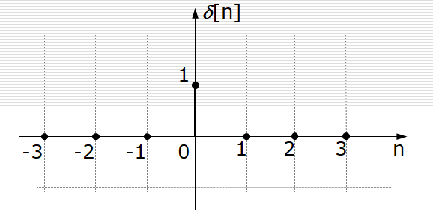
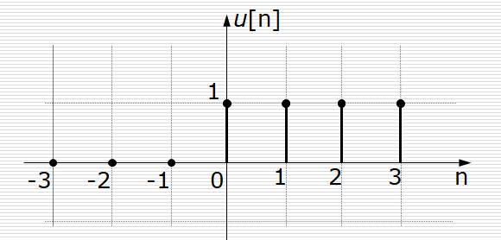
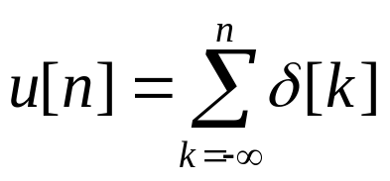

Some Elementary Discrete-Time Signals
Unit sample or “impulse”:
      δ[n] = 1, n=0
      = 0, n≠0.
Unit step:
      u[n] = 1, n≥0
      = 0, n<0.
  Unit step sequence and unit sample can be expressed as a function of the other:

Slide 5
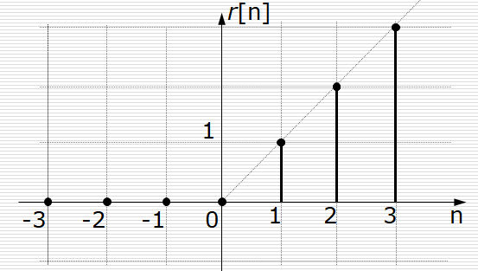
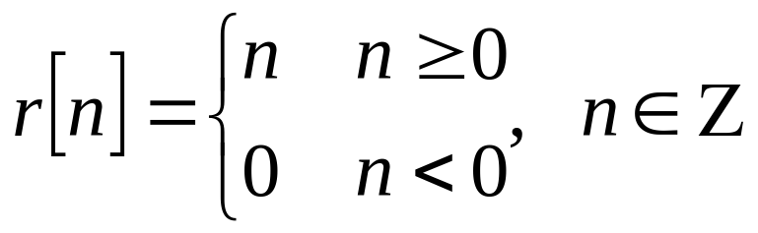
Some Elementary Discrete-Time Signals (cont.)
Unit Ramp:

Slide 6
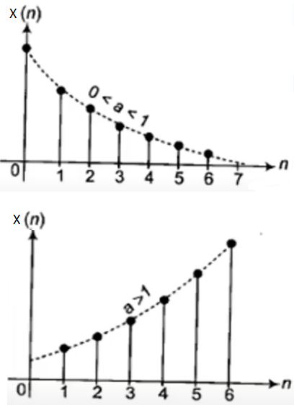
Some Elementary Discrete-Time Signals (cont.)
Exponential sequence
  x[n] = a^{n}
  Properties:
    If a is real then x[n] is real.
    If 0≤a<1, decreasing exponential signal.
    If a>1, then increasing exponential signal.

Slide 7
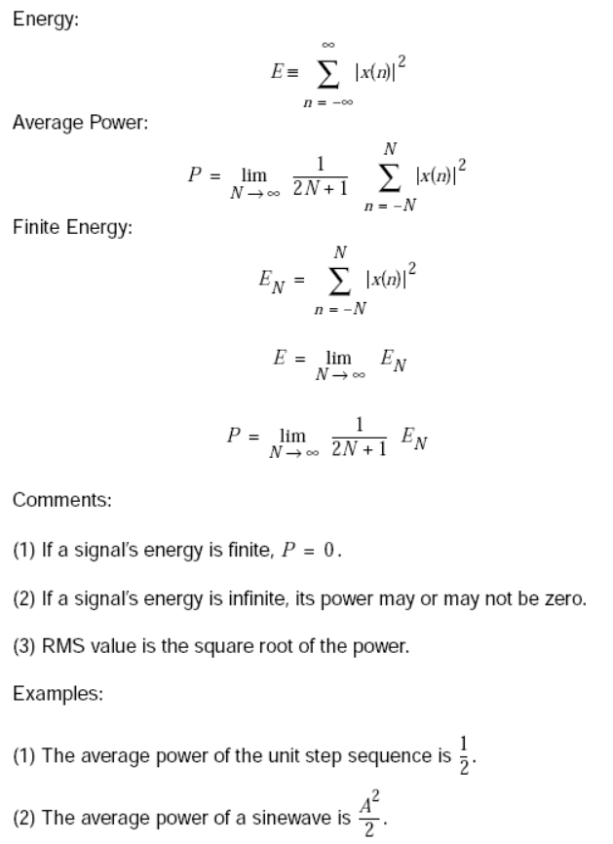
Classification of Discrete-Time Signals

Slide 8
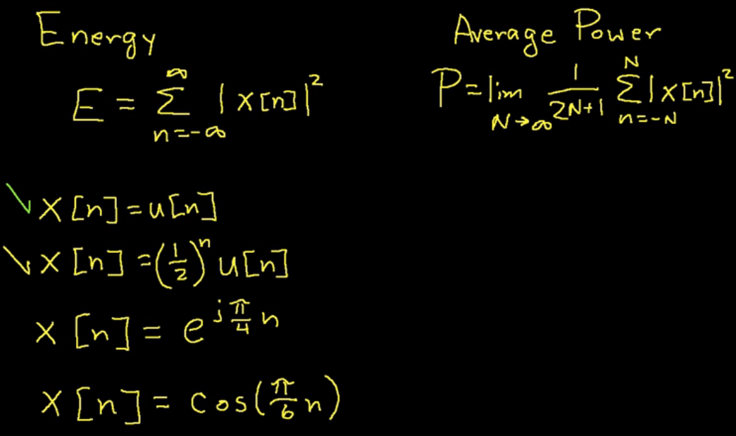
Classification of Discrete-Time Signals

Slide 9
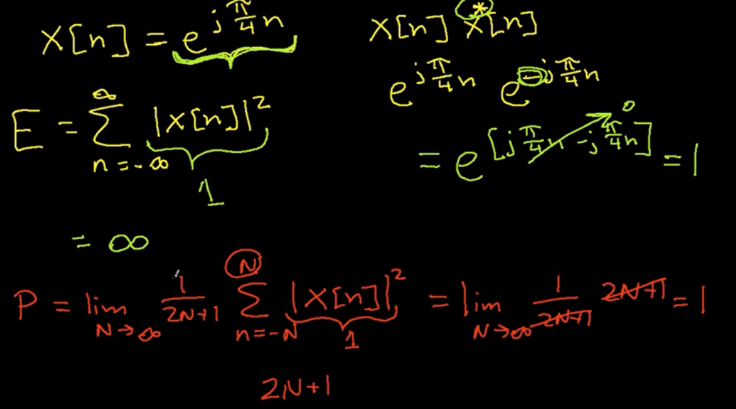
Classification of Discrete-Time Signals

Slide 10
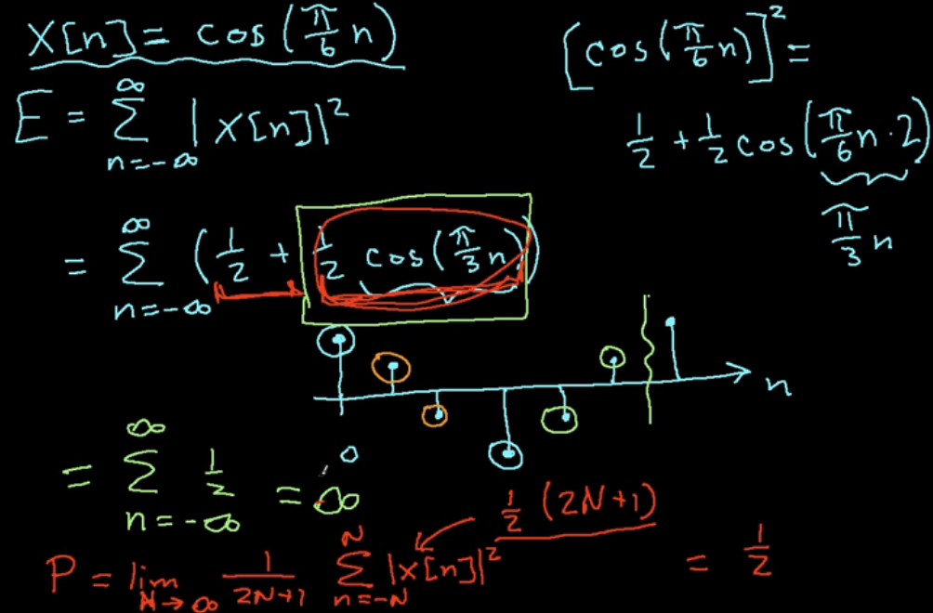
Classification of Discrete-Time Signals

Slide 11
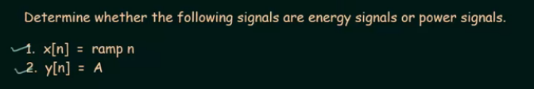
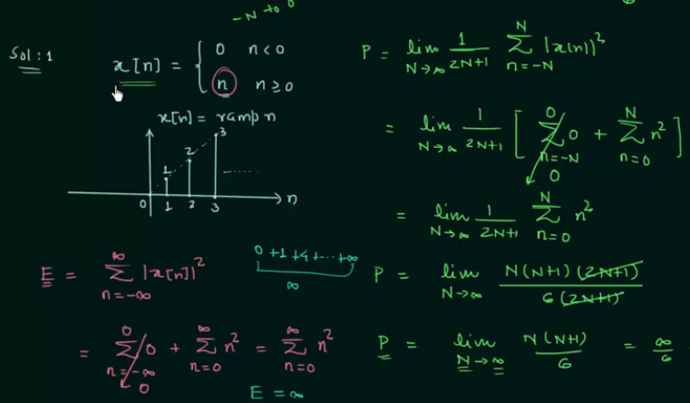
Classification of Discrete-Time Signals

Slide 12
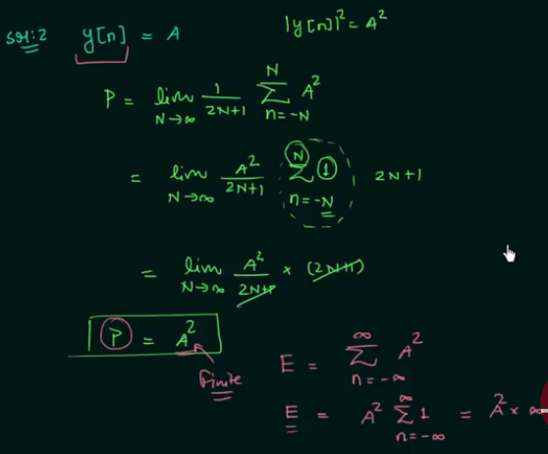
Classification of Discrete-Time Signals

Slide 13
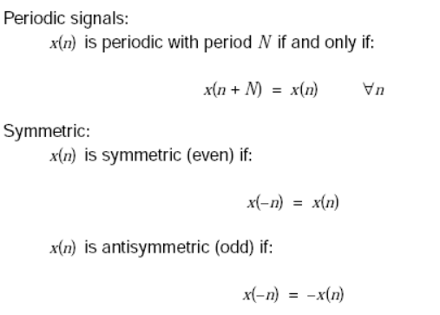
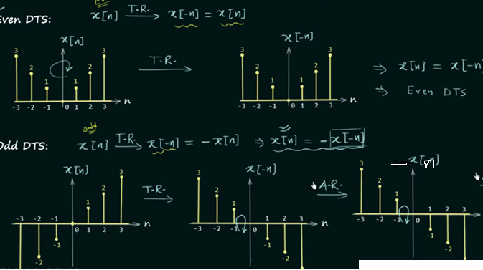
Classification of Discrete-Time Signals (cont.)

Slide 14
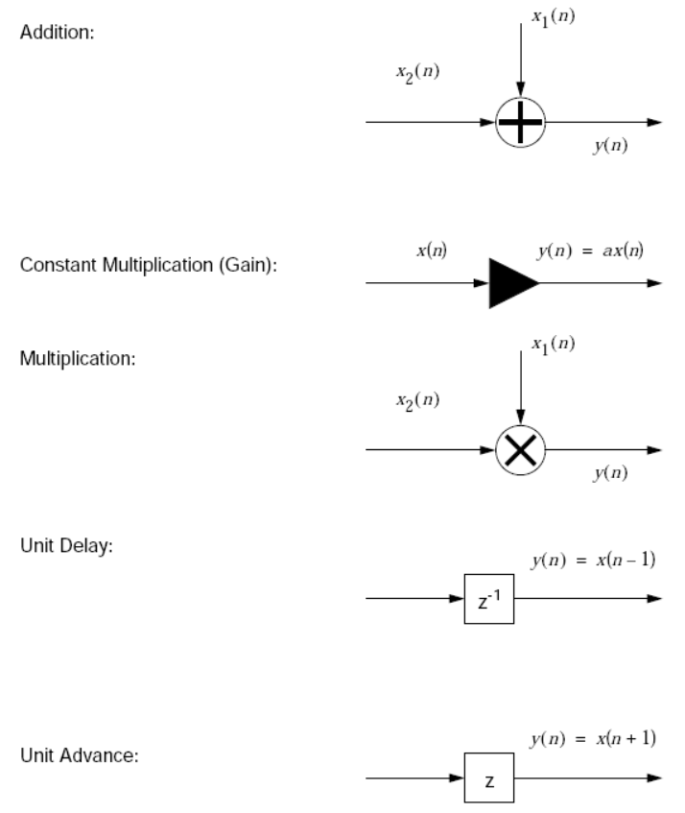
Signal Flow Graphs

Slide 15
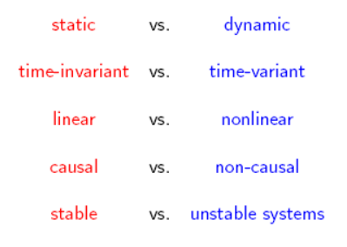
Classification of Discrete-Time Systems

Slide 16

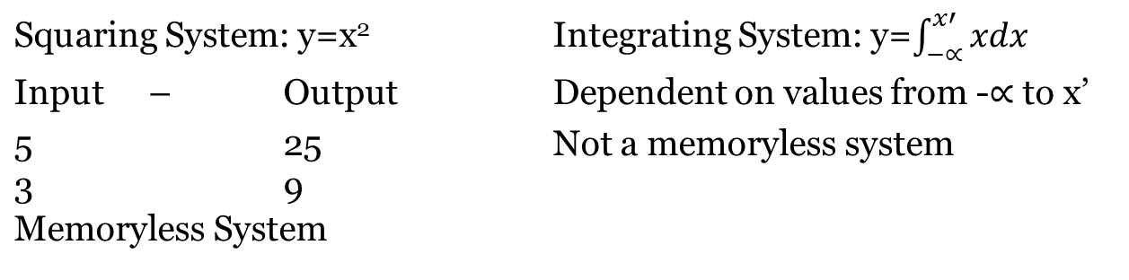
Classification of Discrete-Time Systems (cont.)
Static vs. Dynamic:
  Static system (a.k.a. memoryless): the output at time n depends only on the input sample at time n; otherwise the system is said to be dynamic .
  a system is static iff (if and only if) y(n) = T [x(n), n] ; for every time instant n.

Slide 17

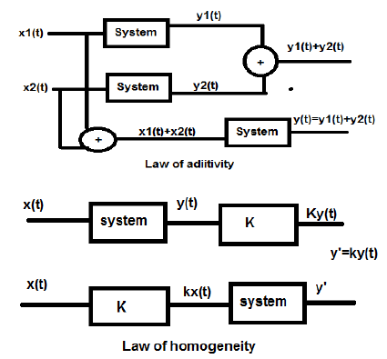
Classification of Discrete-Time Systems (cont.)
  Linear vs. Nonlinear Systems:
    Linear system: obeys superposition principle
    The superposition theorem for electrical circuits states that for a linear system the response (voltage or current) in any branch of a bilateral linear circuit having more than one independent source equals the algebraic sum of the responses caused by each independent source acting alone
    a system is linear iff
    for any arbitrary input sequences x1(n) and x2(n), and any arbitrary constants a1 and a2
Linear System: obeys law of additivity and homogeneity.
Conditions:
Output is 0 if input is 0
There is no non-linear operator
Examples:
y(n)=x(n)+3 -> Violates First condition; non-linear
y(n)=sin(x(n)) -> Violates Second Condition; non-linear
y(n)=5x(n) -> Linear

Slide 18

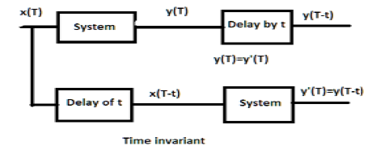
Classification of Discrete-Time Systems (cont.)
Time-invariant vs. Time-variant Systems:
  Time-invariant system: input-output characteristics do not change with time
  a system is time-invariant iff
  for every input x(n) and every time shift k.
Output and input are delayed by same time unit.
Example:
y(T)=x(2T)
Process 1: x(2T)->y(2T)->y(2(T-t))
Process 2: x(2T)->x(2T-t)->y(2T-t)
So, not time invariant
Y(T)=sin(x(T))
Process 1: x(T)->sin(x(T))->sin(x(T-t))
Process 2: x(T)->x(T-t)->sin(x(T-t))
So, time invariant

Slide 19
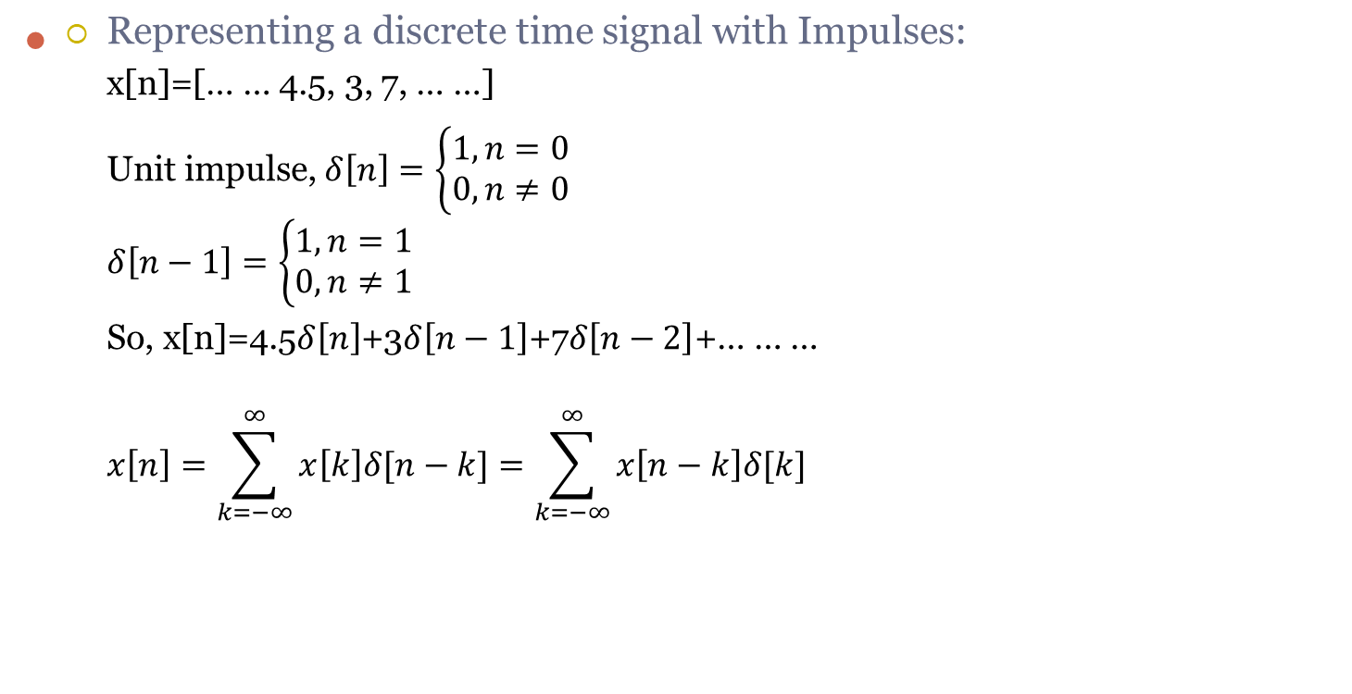
Linear Time Invariant (LTI) System

Slide 20
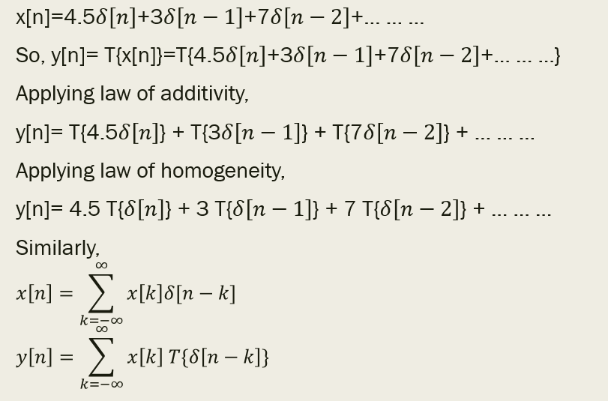
Linear Time Invariant (LTI) System (cont.)

Slide 21
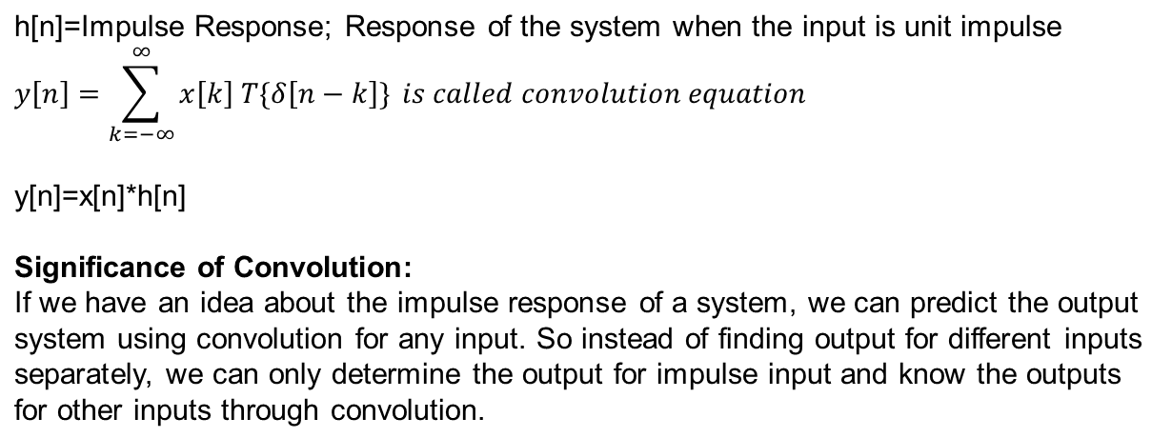
Impulse Response

Slide 22

Classification of Discrete-Time Systems (cont.)
  Causal vs. Non-causal Systems:
  Causal system: output of system at any time n depends only on present and past inputs
  a system is causal iff
  for all n
  That is the output of a causal system never depends on future inputs.
  Online/Real time processing -> Causal System
  Offline processing like video editing -> Non-causal system
  y[n]=x[n]+3x[n-2] -> Causal System
  y[n]=x[n]+3x[n-2] + x[n+1] -> Non-causal System

Slide 23
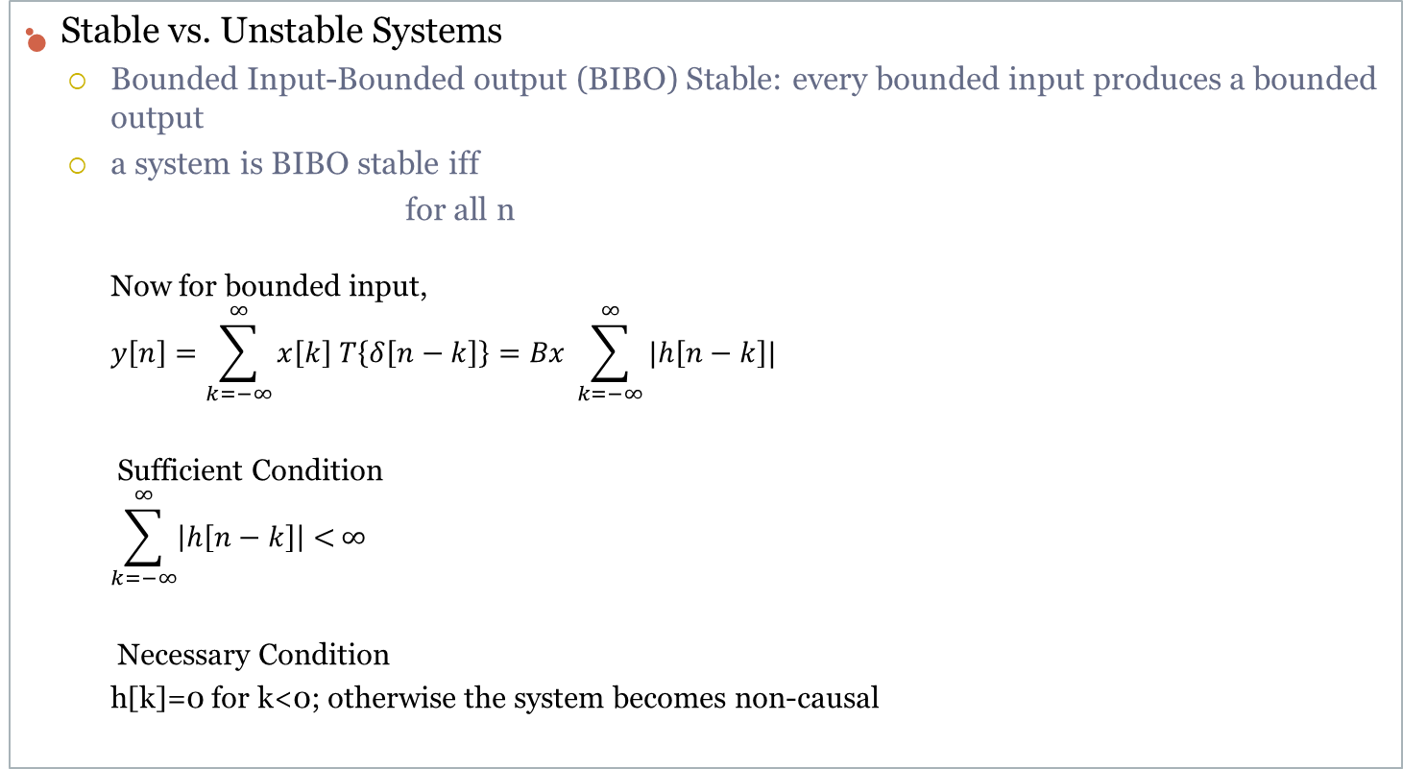

Classification of Discrete-Time Systems (cont.)

